Slide 1
TradeAide: Automated Stock Market Prediction
Daniel Rozenzaft, Yaroslava Shynkar, Jonathan Kelaty

Slide 2
Problem Description
Use machine learning methods to predict stock movements and optimal times to buy and sell
Implement several algorithms (LSTM, RL, RF, SVM) and compare results with the state of the art
Incorporate news sentiment analysis as a feature
State of the Art: Nabapour et al. and Yang et al. suggest that LSTM and RF predict price movements best. Our hypothesis is that this will be our result, and that the news sentiment feature will improve model performance.
SVM and ANN are also effective (Hiba Sadia et al.).
RL will make sound decisions on when buy/sell/hold, leading to a solidly positive ROI
Notes:
Why the problem is challenging: the stock market is unpredictable: its movements depend on many variables, some of which are hard to quantify. Large, representative samples—high frequency trading data collected over long periods of time—create very large state spaces.

Slide 3
Roles
Jonathan - built trained, tested SVM and RF
Initial lead on NLP, method exploration
Yaroslava - built, trained, tested LSTM/ANN
Exploration of financial news dataset features
Daniel - built, trained, and tested reinforcement (Q) learning agent
Preprocessed and redesigned NLP dataset

Slide 4
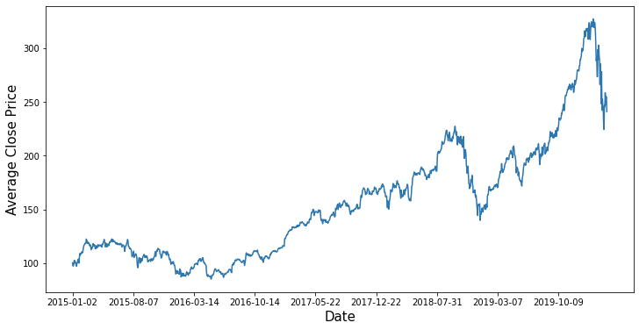
SVM and Random Forests
Hiba Sadia et al. found that SVM and RF were two strong predictors of stock price trends
Feature set:
Running [up to] 5 day average of the adjusted close price
Running [up to] 5 day average of the news sentiment
Volatility–ratio of previous two days’ adjusted close price
Didn’t generalize for stock data during 2019 - 2020
COVID
Economy likely treats certain stocks differently over time, so historic data becomes less relevant for future predictions
Due to company growth, adapting markets, etc...

Slide 5
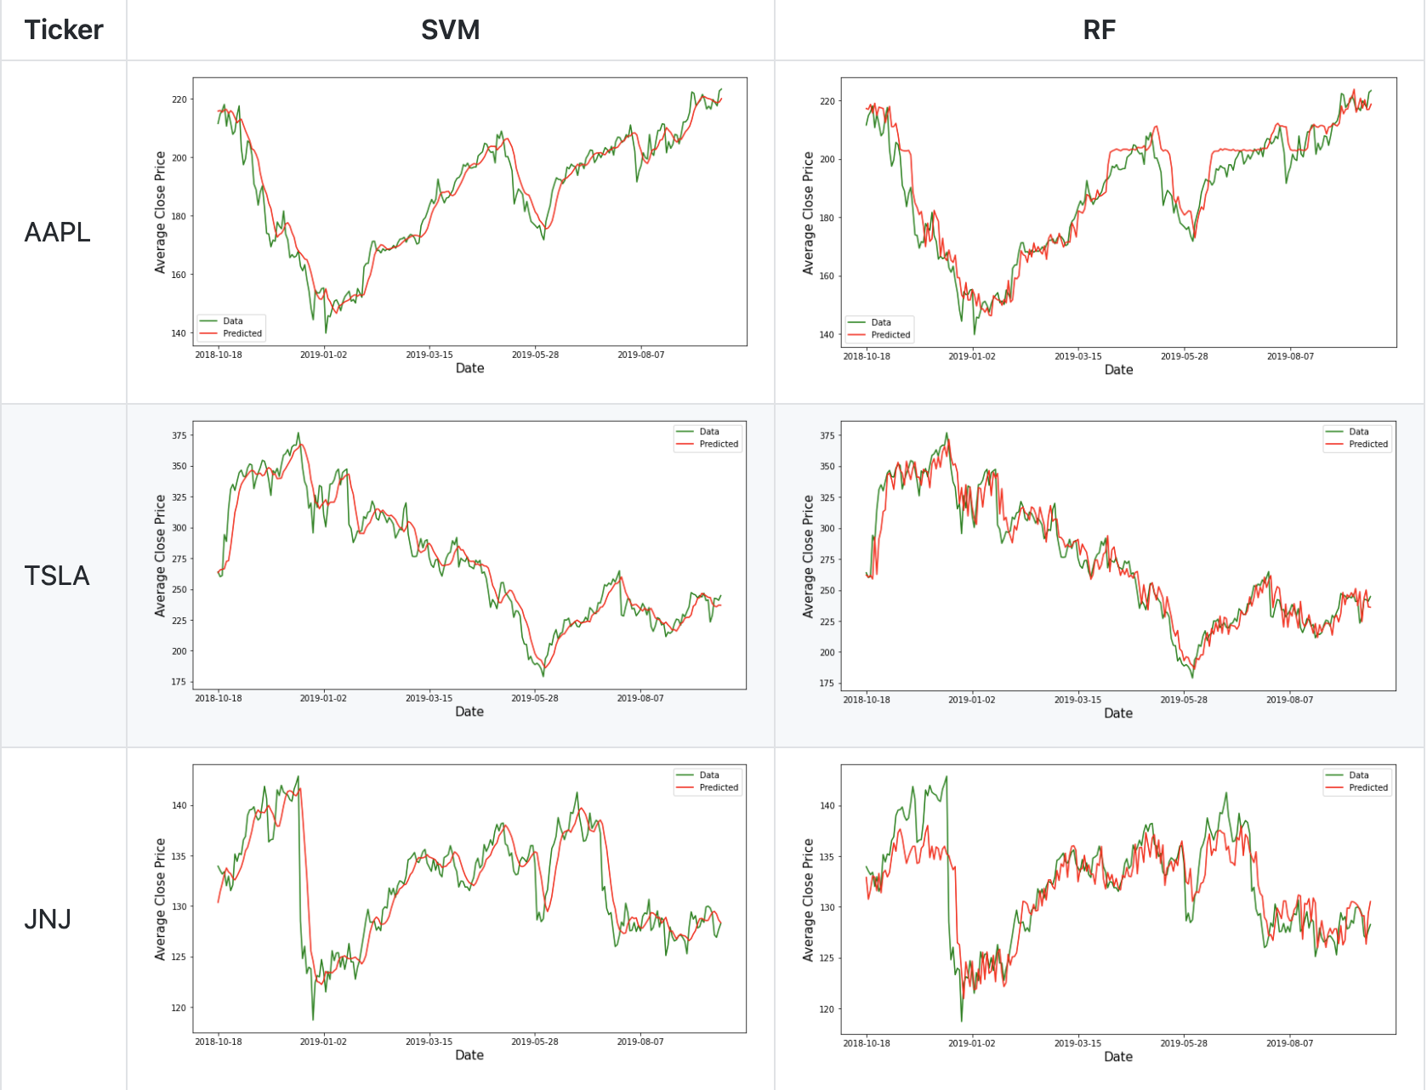
SVM and Random Forests Results
Evaluated each model on the set of stocks: Apple (AAPL), Tesla (TSLA), and Johnson & Johnson (JNJ)
SVM model predicted stock values formed a smooth approximation, which closely mapped to the actual stock prices.
RF was far more sensitive to the rapidly changing day-to-day stock values, while arguably more closely resembling real-world behavior.

Slide 6
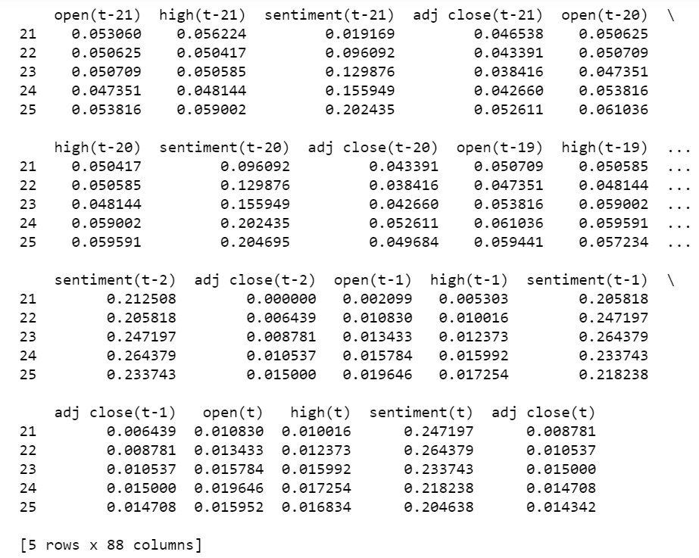
LSTM Model Creation
Data preparation (in the input layer): prepForLSTM() creates the aggregated input
-> The input layer is built the data of 3 weeks & aims to predict 1 day in the future
->The columns used to create the preparation layer are “open”, “high”, “sentiment”, and “adj close.”
->The processed data is scaled and split into a train set and test set. (Supervised learning)
We used the hyperparameters outlined by Nabipour et al. to train our LSTM model.

Slide 7
2. LSTM Parameters
We ran the Sequential model with parameters “Neuron type” = “LSTM”, ‘monitor’ = “val_loss”, “verbose” = 1, “patience” = 100 epochs, “learning rate”= 0.00005, “beta_1” = 0.9, “beta_2” = 0.999, “batch_size” = 8, “validation_split” = 0.2, “callbacks” = “early stopping”.
Total number of parameters equal to 1,010,501. Total #training days = 1000
Reshaped format of X_train,y_train, x_test, y_test is (1000,21,4) (1000,1), (237, 21, 4)(237,1)
3. Model Training using optimal parameters
Layer (type) Output Shape Param #
=================================================================
lstm (LSTM) (None, 500) 1010000
_________________________________________________________________
dense (Dense) (None, 1) 501
4. Comparing Training loss and Validation Loss
5. Making a prediction on the test dataset
6.Graph representation of scaled real and predicted data

Slide 8
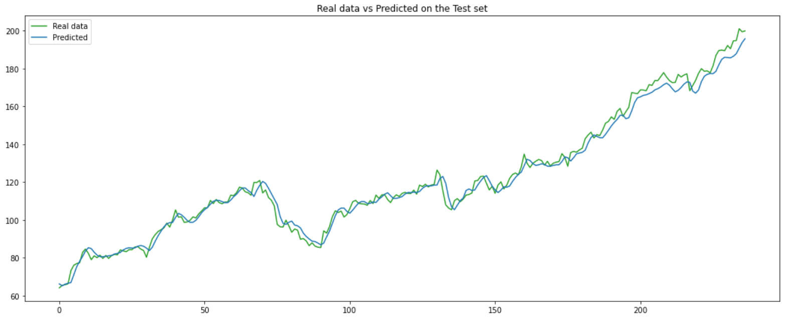
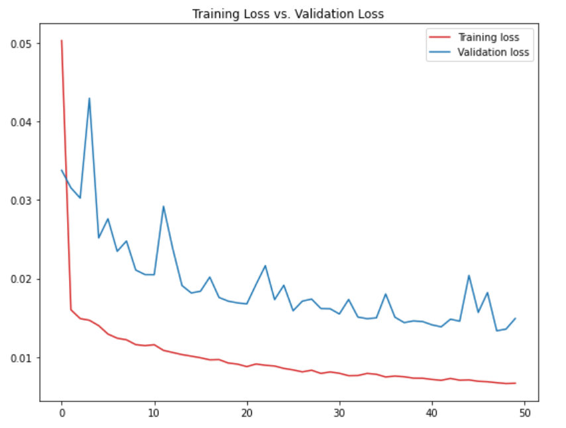
Experiments and Evaluation for Apple
MAE = 0.0067
MSE = 9.4305e-05
Final value of cost function for cross-validation data
val_loss = 0.0149
MSE of cross-validation data:
val_mse = 3.6786e-04
MAE of cross-validation:
val_mae = 0.0149
The prediction on the test dataset gave us a Root Mean Square Deviation (RMSE) equal to 3.60.

Slide 9
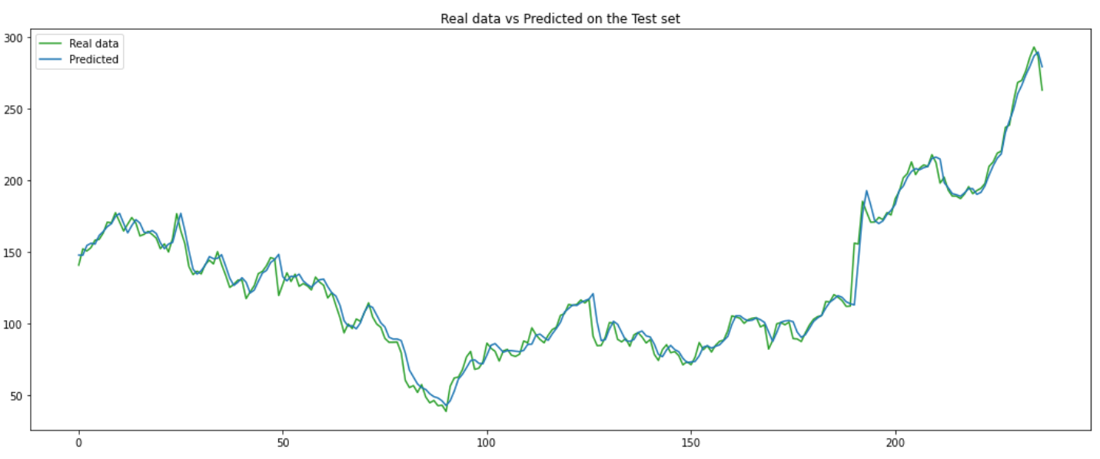
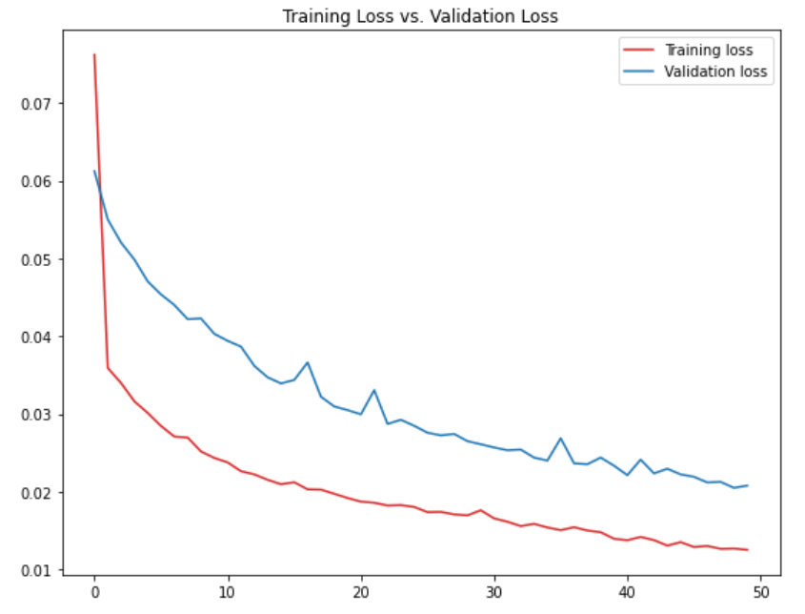
Experiments and Evaluation for Tesla
MAE = 0.125
MSE = 3.2459e-04
Final value of cost function for cross-validation data
val_loss = 0.208
MSE of cross-validation data:
val_mse = 9.1789e-04
MAE of cross-validation:
val_mae = 0.0208
The prediction on the test dataset gave us a Root Mean Square Deviation (RMSE) equal to 6.52

Slide 10
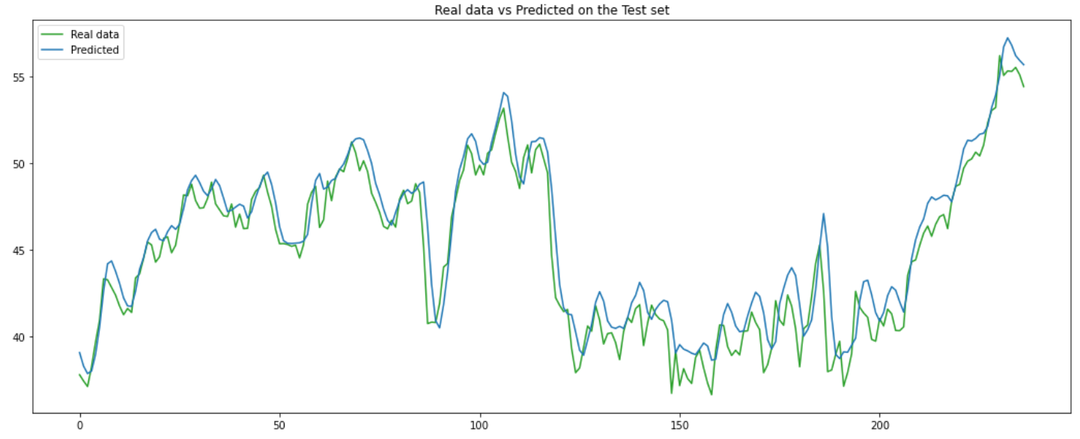
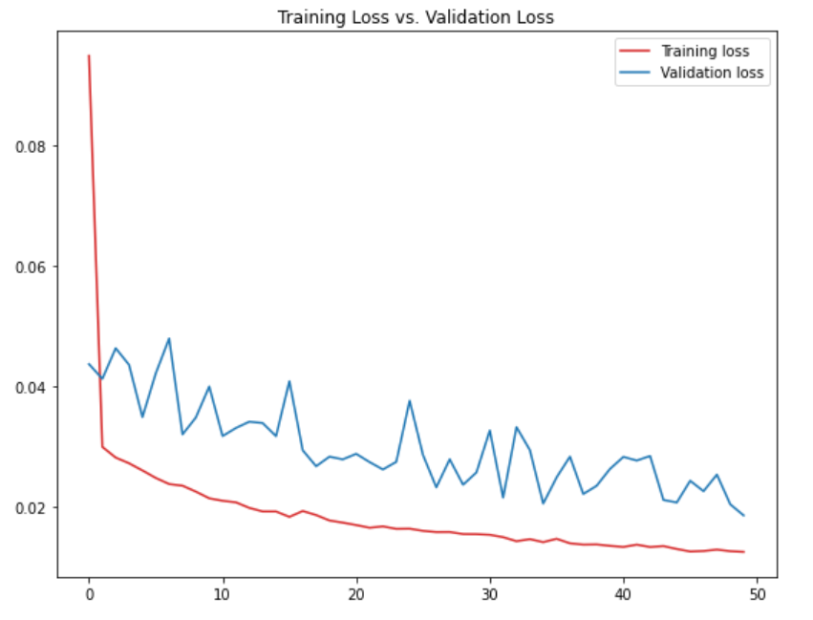
Experiments and Evaluation for Johnson & Johnson
MAE = 0.125
MSE = 2.9869e-04
Final value of cost function for cross-validation data
val_loss = 0.0185
MSE of cross-validation data:
val_mse = 8.5810e-04
MAE of cross-validation:
val_mae = 0.0185
The prediction on the test dataset gave us a Root Mean Square Deviation (RMSE) equal to 1.49

Slide 11
ANN to predict the news sentiment
Based on "open", "close", Moving Average "MA" and "adj close" features
The purpose: to fill in the missing data on news sentiment
MA is a technical indicator, labels = ‘sentiments’
Optimal Model MLPClassifier(activation='logistic', alpha=0.1, hidden_layer_sizes=(3,),
learning_rate='adaptive', random_state=42, solver='sgd',
verbose=True)
No. of Iterations: 175 Training Accuracy: 0.793, Test Accuracy: 0.829

Slide 12
Reinforcement Learning: MDP
State s = [price, volume, sentiment]
A vector including price trend (increasing, decreasing, same), trading volume (high, med, low), and new sentiment (pos, neg, neutral)
Action a = one of [‘buy’, ‘sell’, ‘hold’]
Reward r(s, a, s’) from taking action a in state s upon arriving in the next state s’.
Daily P/L
Policy π(s): trading strategy at state s, represented by the probability distribution of actions at state s
Q-value Q_{π} (s, a): expected long-term reward of taking action a at state s following policy π.
Notes:
Q-matrix consists of all possible states as rows and all possible actions as columns

Slide 13
RL: Training the Q-Learning Algorithm
Build out a Q-matrix, consisting of the expected long-term reward of taking action a while in state s.
Rows: state space (3³ = 27)
Columns: action space (3)
Update Q-values at each iteration
Decayed-epsilon-greedy method
Decay ε, the probability of selecting a random action with each iteration
Discount Factor, γ
Balance short and long-term reward
Risk Level, L – negative penalty on holding
Novel volatility weighting – based on numerical distance from L
Notes:
So we took the Q-Learning approach to the RL component of our project. I’m going to be repeating a few things from the Voicethread lecture, but we’re essentially building out a matrix of the expected long-term reward of each state-action pair. Each row is a state in the state space, and each column is an action in the action space.
We update values in the Q-matrix according to the standard formula, which you can see here. We also have a parameter epsilon, which is the probability with which we select a random action during the training phase. We decay it over time based on the number of iterations – this is the decayed-epsilon-greedy method. In our updating formula we also have the parameter gamma, which balances the agent’s preference for short term and long term reward. A gamma value of 0 means that the agent only pursues immediate reward, while a gamma of 1 means that it pursues long-term reward.
Lastly, some of our more novel components are our user-set risk level, L, which is a negative offset on holding. Risk-seeking investors have the option of setting a high value of L if they so desire. We also have our novel volatility weighting method, which, to briefly summarize, multiplies each Q value by the numerical distance between the risk level and the average 5-day volatility of the trading days when the market was in that state.

Slide 14
Reinforcement Learning: Evaluation
We trained and tested our agent on 135 different combinations of hyperparameters—learning rate, risk level, epsilon, gamma—and found which individual hyperparameter values (e.g. α = 0.01) yielded the highest profit on average. The best-performing value in each parameter “category” was selected for the testing phase.
Our main evaluation metric was the percent of the maximum profit captured (p) by a sample of 25 trainings and test runs, on average. The maximum profit was defined as the largest profit value attained during the hyperparameter tuning stage.
We quantified our results by setting up a 95% confidence interval for p.
Notes:
To find the optimal model, we trained it on 135 combinations of hyperparameters. For each individual parameter value that we tested, we found the average ROI that it yielded. We selected the highest-yielding parameters and used them in our testing phase.
The testing phase involved training the model on the optimal hyperparameters 25 times, generating a sample of the proportion of maximum profit captured, or p. Here, the maximum profit was the maximum ROI reached during the model selection step.
And finally, we quantified our results by setting up a 95% confidence interval for p.

Slide 15

Reinforcement Learning: Results (May Vary)
Our agent performs extremely well on tech stocks!
Apple | Tesla | Johnson & Johnson | Microsoft
Notes:
Here are some examples of those confidence intervals. As you can see, the two tech stocks, Apple and Microsoft, saw significantly better performance. We speculate that this is because those stocks’ prices generally followed a similar progression in 2019, our test year, to 2015–2018, our training and validation years. This contrasts with something like Tesla, which is famous for its extreme volatility, and JNJ, on which you could see an immediate trend reversal if you look at its five-year price data.

Slide 16
Overall Observations and Areas for Future Work
Financial news data is prone to bias
Analysts do not want to lose their sources
Tweets may be a more objective measure
More accurate volatility weighting system
Volatility weighting in Q-learning implementation led to somewhat marginal gains
Larger training and validation datasets
The years 2015-2018 are not necessarily representative of 2019, and certainly not 2020!
Limited by slow runtime

Slide 17
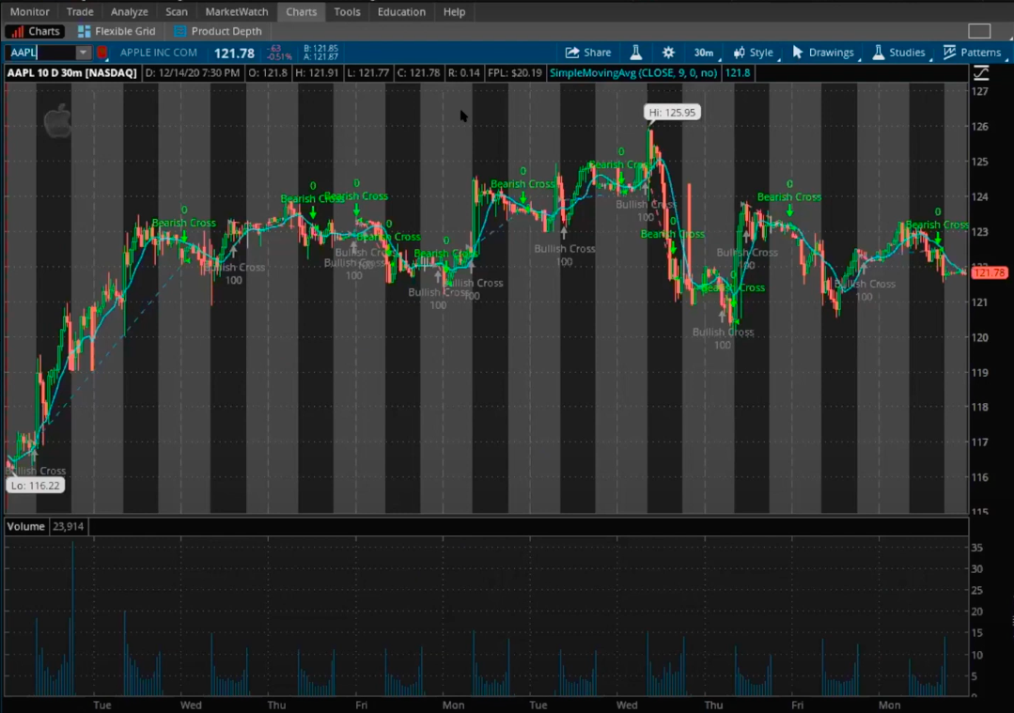
Thank You

